Slide 2
Learning Objectives
LO 3.1 List the main characteristics that an Earth material must possess to be considered a mineral and describe each characteristic.
LO 3.2 Compare and contrast the three primary particles contained in atoms.
LO 3.3 Distinguish among ionic bonds, covalent bonds, and metallic bonds.
LO 3.4 List and describe the properties used in mineral identification.
LO 3.5 Explain how minerals are classified and name the most abundant mineral group in Earth’s crust.

Slide 3
Learning Objectives (cont.)
LO 3.6 Sketch the silicon–oxygen tetrahedron and explain how this fundamental building block joins together to form various silicate structures.
LO 3.7 Compare and contrast the light (nonferromagnesian) silicates with the dark (ferromagnesian) silicates and list three common minerals in each group.
LO 3.8 List the common nonsilicate minerals and explain why each is important.
LO 3.9 Discuss Earth’s mineral resources in terms of renewability. Differentiate between mineral resources and ore deposits.

Slide 4
3.1 Minerals: Building Blocks of Rocks
Definition of a mineral
Naturally occurring
Inorganic
Solid
Ordered internal molecular structure
Definite chemical composition
Definition of a rock
A solid aggregate or mass of minerals

Slide 5
3.2 Atoms: Building Blocks of Minerals
Atomic structure
Central region called the nucleus
Consists of protons (positive charges) and neutrons (neutral charges)
Electrons
Negatively charged particles that surround the nucleus
Located in discrete energy levels called shells

Slide 6
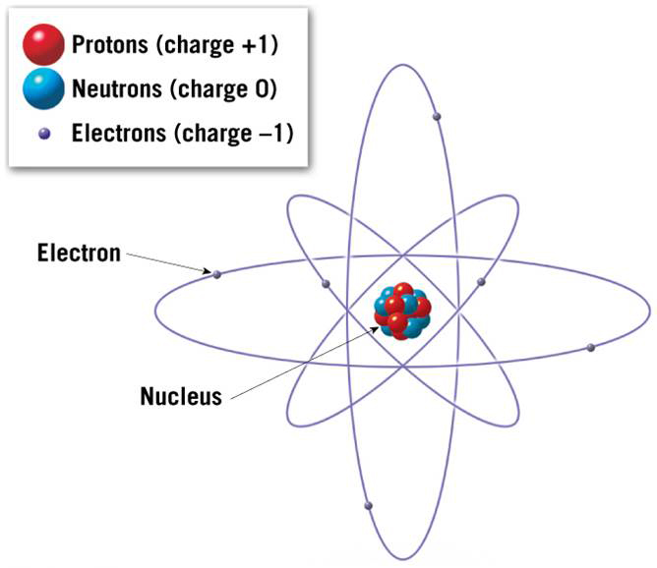
Idealized Structure of an Atom

Slide 7
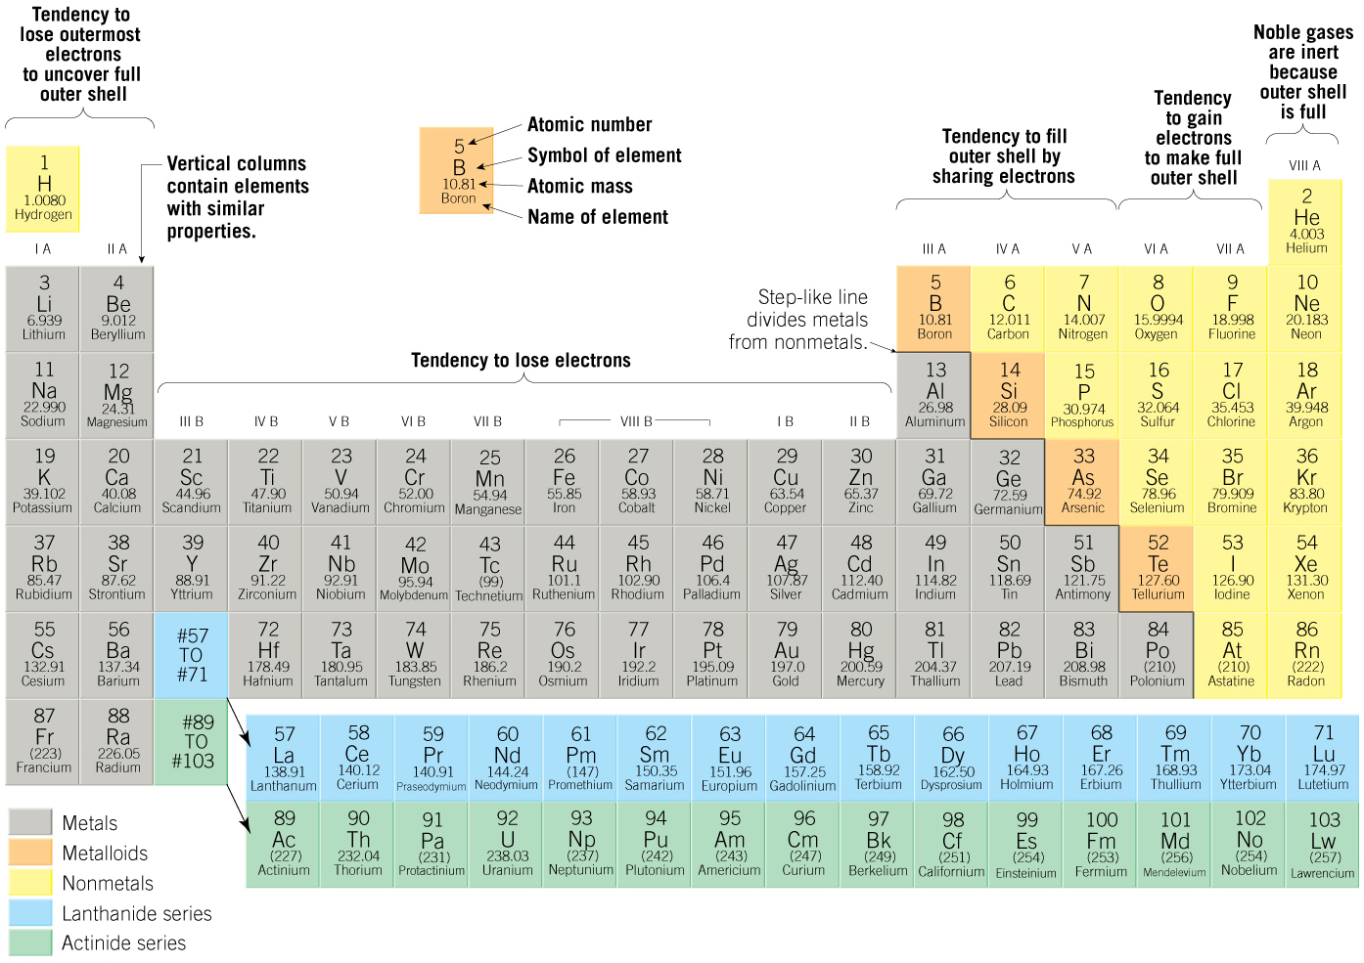
Elements: Defined by Their Number of Protons

Slide 8
3.3 Why Atoms Bond
Chemical bonding
Formation of a compound by combining two or more elements by transferring or sharing electrons
Ionic bonding
Atoms gain or lose outermost (valence) electrons to form ions
Ionic compounds consist of an orderly arrangement of oppositely charged ions

Slide 9
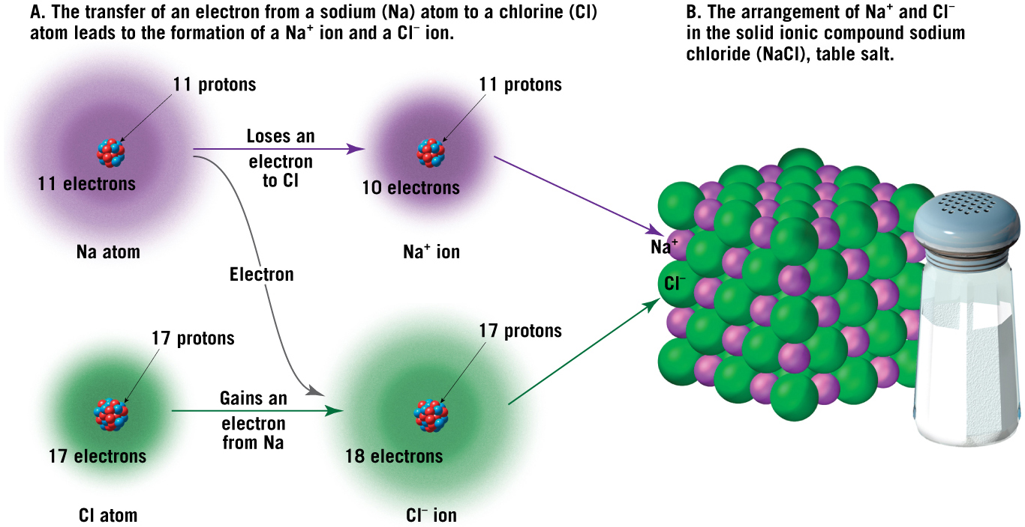
Halite (NaCl): An Example of Ionic Bonding

Slide 10
3.3 Why Atoms Bond
Covalent bonding
Atoms share electrons to achieve electrical neutrality.
Covalent compounds are generally stronger than ionic bonds.
Both ionic and covalent bonds typically occur in the same compound (bonds are seldom 100 percent ionic or covalent in character).

Slide 11
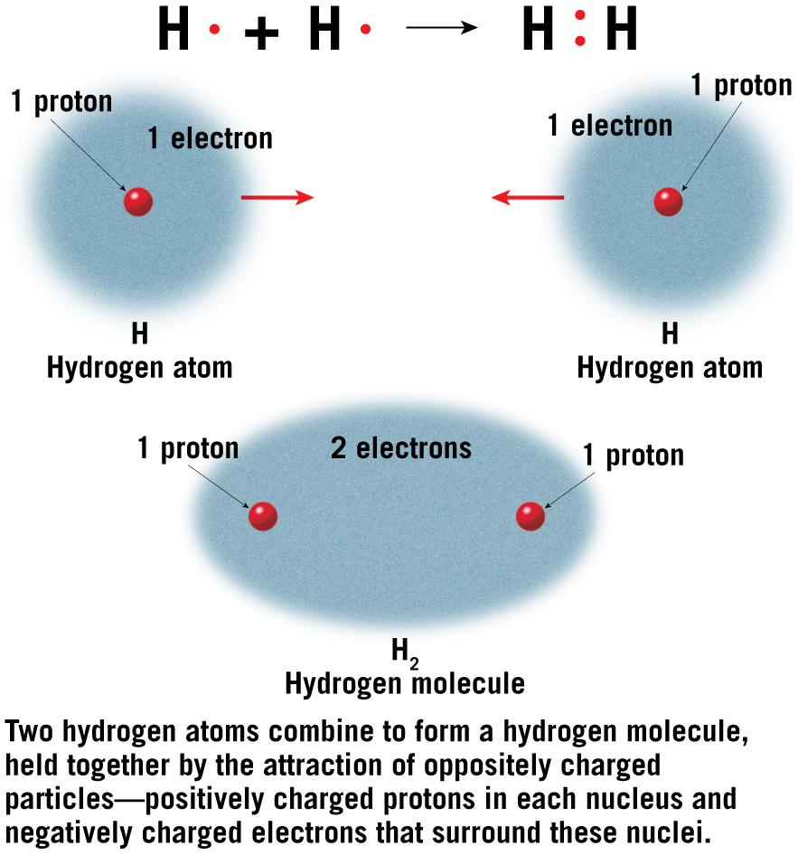
Covalent Bonding: Sharing of Valence Electrons

Slide 12
Composition of Minerals
Metallic bonding
Valence electrons are free to migrate among atoms
Weaker and less common than ionic or covalent bonds

Slide 13
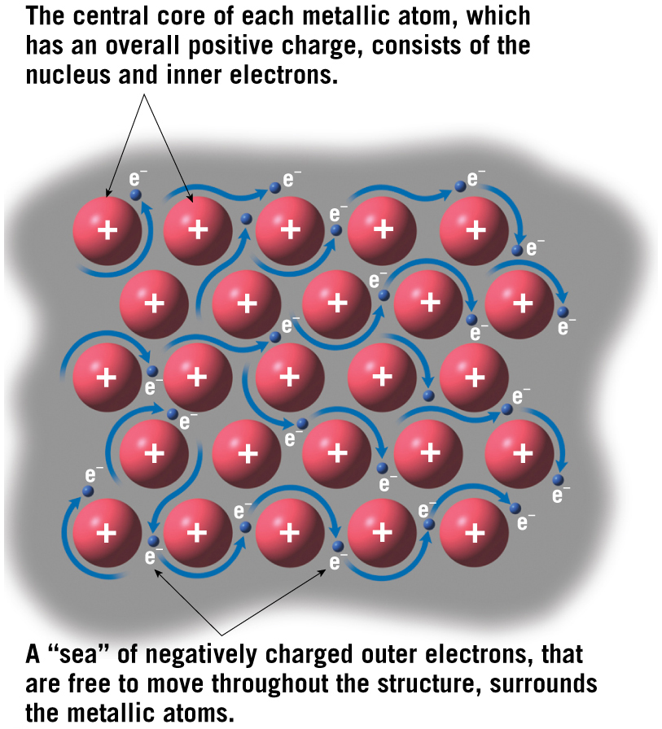
Metallic Bonding

Slide 14
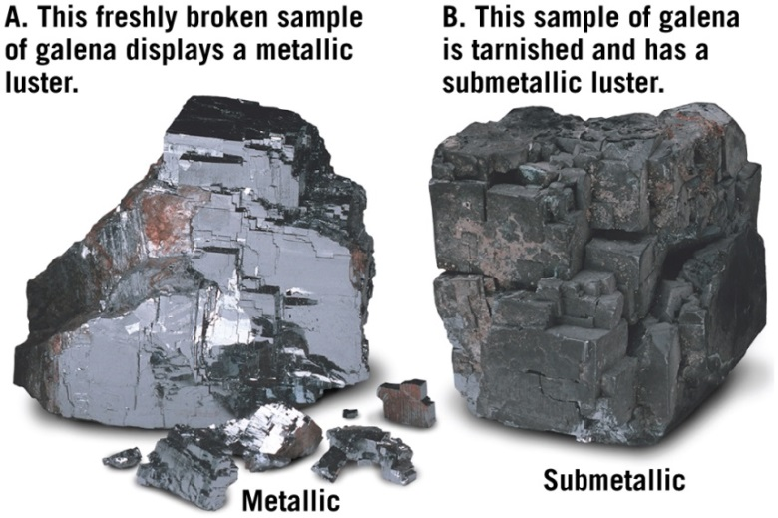
3.4 Properties of Minerals
Optical Properties
Luster
Appearance of a mineral in reflected light
Two basic categories
Metallic
Nonmetallic
Other terms are used to further describe luster such as vitreous, silky, or earthy.

Slide 15
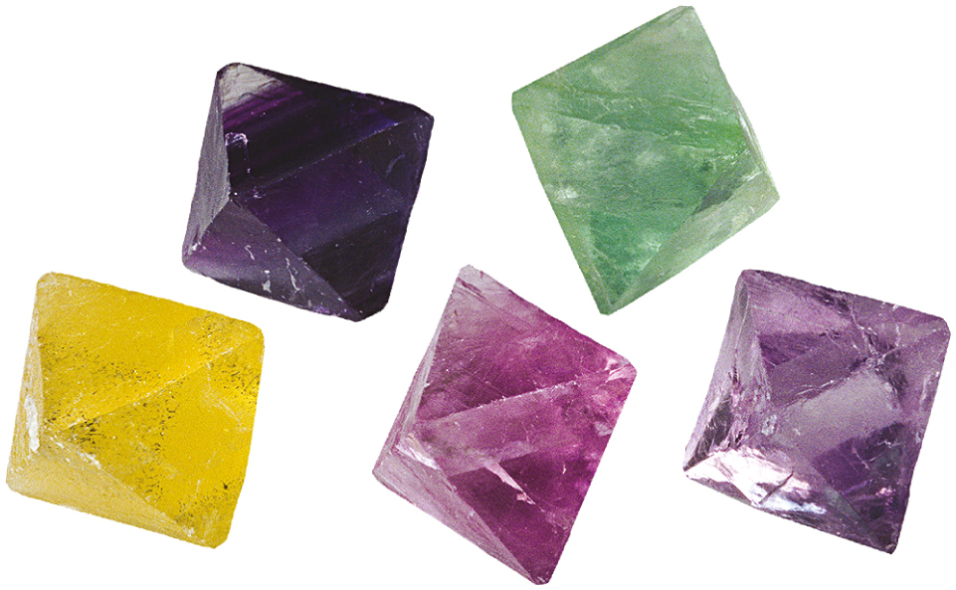
3.4 Properties of Minerals (cont.)
Optical Properties
Color
Generally an unreliable diagnostic property to use for mineral identification
Often highly variable for a given mineral because of slight changes in mineral chemistry
Exotic colorations of some minerals produce gemstones
Tutorial

Slide 16
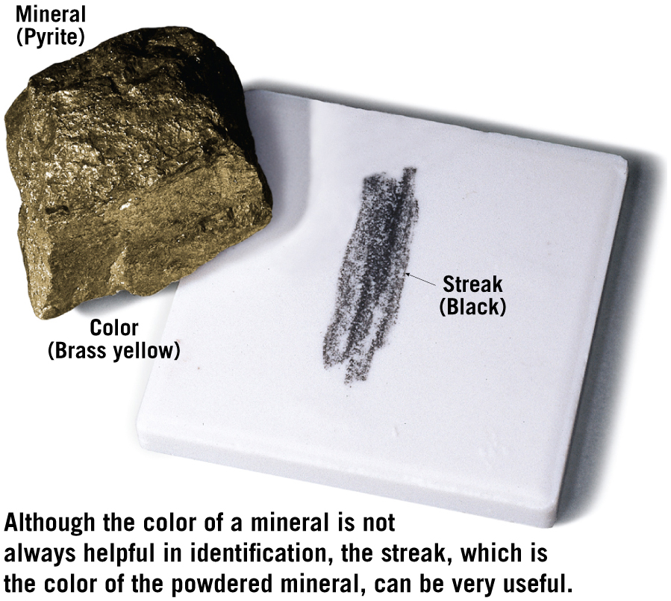
3.4 Properties of Minerals (cont.)
Optical Properties
Streak
Color of a mineral in its powdered form
Helpful in distinguishing different forms of the same mineral
Video

Slide 17
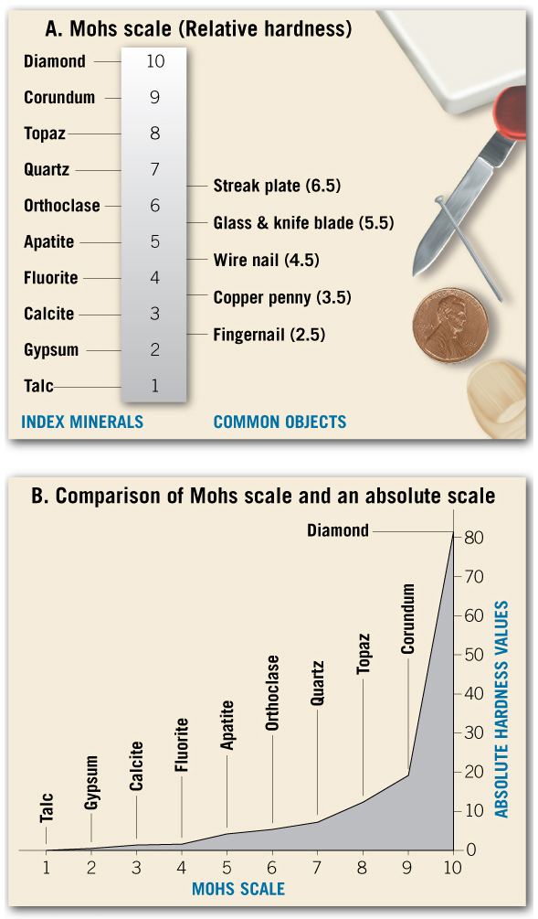
3.4 Properties of Minerals (cont.)
Tutorial
Mineral Strength
Hardness
Resistance of a mineral to abrasion or scratching
All minerals are compared to a standard scale called the Mohs scale of hardness

Slide 18
3.4 Properties of Minerals (cont.)
Mineral Strength
Cleavage
Tendency to break along planes of weak bonding
Produces flat, shiny surfaces
Described by resulting geometric shapes
Number of planes
Angles between adjacent planes

Slide 19
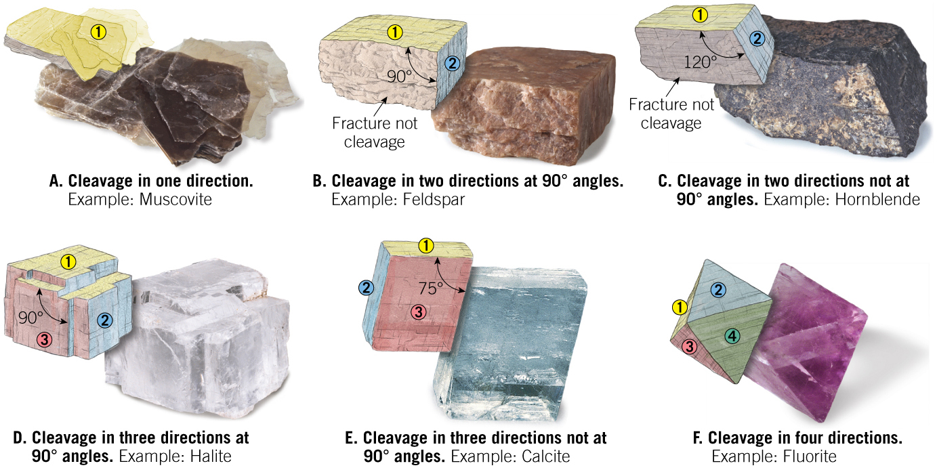
Common Cleavage Directions
Tutorial

Slide 20
3.4 Properties of Minerals
Specific gravity
Ratio of the weight of a mineral to the weight of an equal volume of water
Average value is approximately 2.7

Slide 21
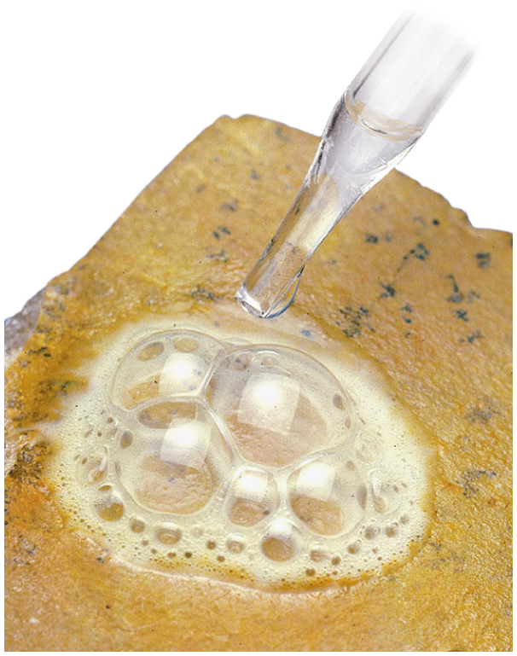
3.4 Properties of Minerals (cont.)
Other properties
Magnetism
Reaction to hydrochloric acid
Malleability
Double refraction
Taste
Smell
Elasticity
Video

Slide 22
3.5 Mineral Groups
Nearly 4000 minerals have been identified on Earth
Rock-forming minerals
Common minerals that make up most of the rocks of Earth’s crust
Only a few dozen members
Composed mainly of the eight elements that make up more than 98 percent of the continental crust

Slide 23
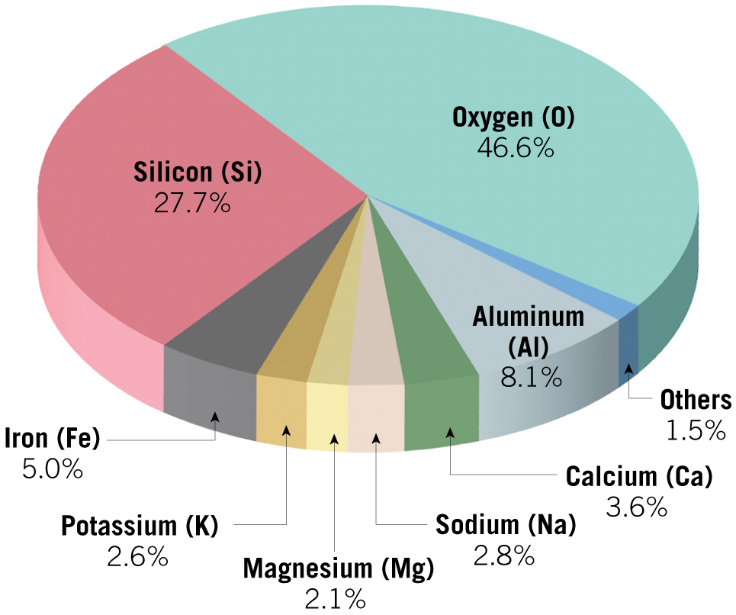
Elemental Abundances in Continental Crust

Slide 24
3.6 The Silicates
Silicates
Most important mineral group
Comprise most of the rock-forming minerals
Very abundant as a result of large amounts of silicon and oxygen in Earth’s crust
Basic building block is the silicon–oxygen tetrahedron molecule
Four oxygen ions surrounding a much smaller silicon ion

Slide 25
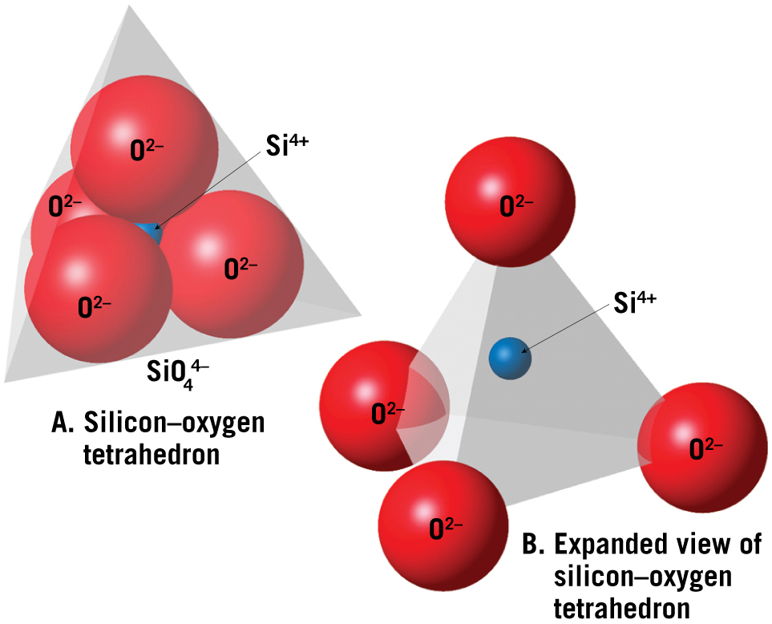
Two Illustrations of the Si–O Tetrahedron

Slide 26
3.6 The Silicates
Silicate structures
Single tetrahedra are linked together to form various structures including
Isolated tetrahedra
Ring structures
Single- and double-chain structures
Sheet or layered structures
Complex three-dimensional structures

Slide 27
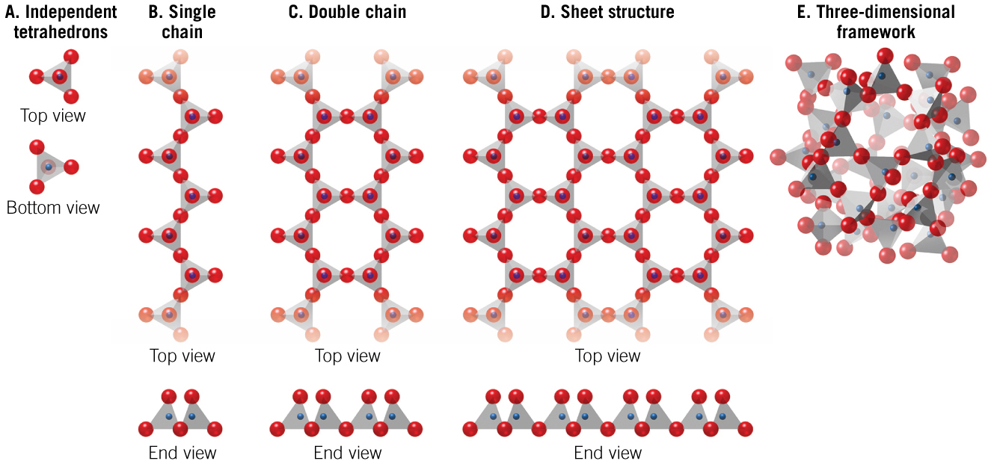
Five Basic Silicate Structures
Tutorial

Slide 28
3.6 The Silicates
Joining silicate structures
Most silicate minerals have a net negative charge (except for quartz)
Metal ions are required to balance the charge
These positive ions bond with unshared oxygen ions in the tetrahedra
Most common ions are Fe²⁺, Mg²⁺, K⁺, Na⁺, Al³⁺, Ca²⁺

Slide 29
3.6 The Silicates (cont.)
Joining silicate structures
Covalent silicon–oxygen bonds are typically stronger than the ionic bonds of the silicate structure.
Controls the cleavage and hardness of minerals
Examples:
Quartz has a three-dimensional framework, is very hard, and lacks cleavage.
Talc has a sheet structure framework bonded with Mg ions and is a very soft mineral.

Slide 30
3.7 Common Silicate Minerals
The Light Silicates
Generally light in color
Specific gravity of approximately 2.7
Lack iron and magnesium
Contain varying amounts of aluminum, potassium, calcium, and sodium
The Dark Silicates
Generally dark in color
Specific gravity between 3.2 and 3.6
Contain iron and/or magnesium

Slide 31
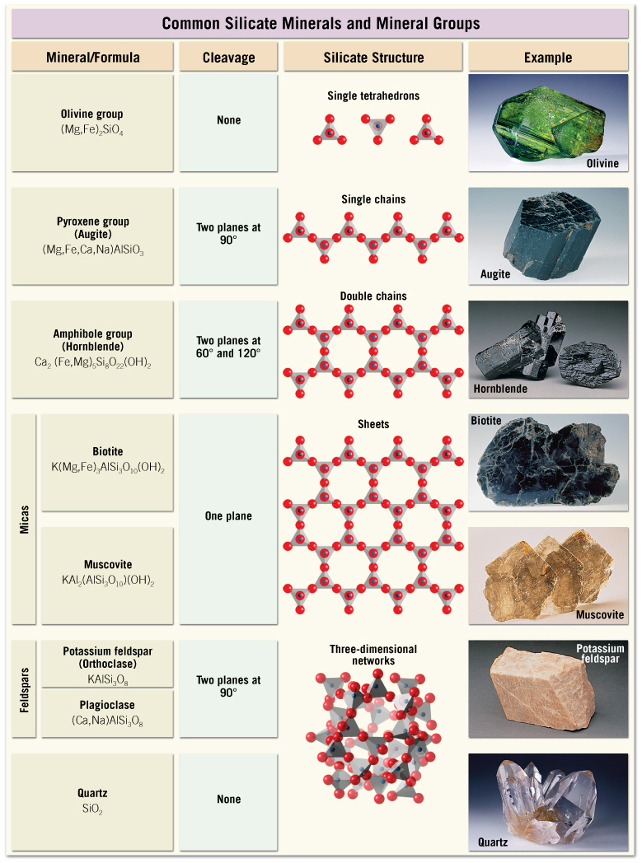
Common Silicate Minerals

Slide 32
3.7 Common Silicate Minerals
The light silicates
Feldspar Group
The most common silicate group and makes up more than 50% of Earth’s crust
Forms under a wide range of temperatures and pressures
Exhibits two directions of perfect cleavage at 90 degrees
Two most common members:
Orthoclase (potassium feldspar)
Plagioclase (sodium and calcium feldspar)

Slide 33
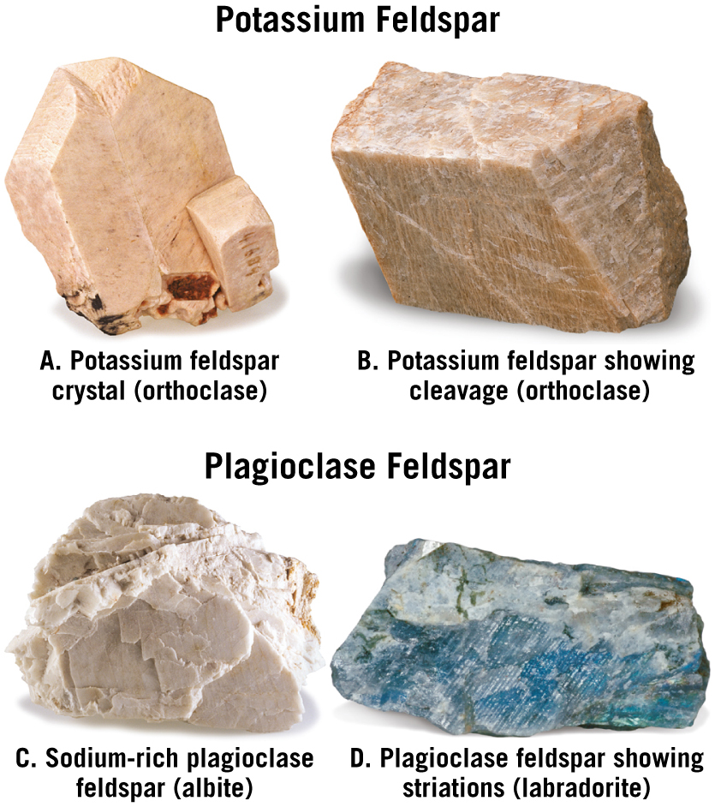
Feldspar Minerals

Slide 34
3.7 Common Silicate Minerals
The light silicates
Quartz
The second-most abundant mineral in the continental crust
Only common mineral made completely of silicon and oxygen
Hard and resistant to weathering
Conchoidal fracture
Often forms hexagonal crystals
Colored by impurities (various ions)

Slide 35
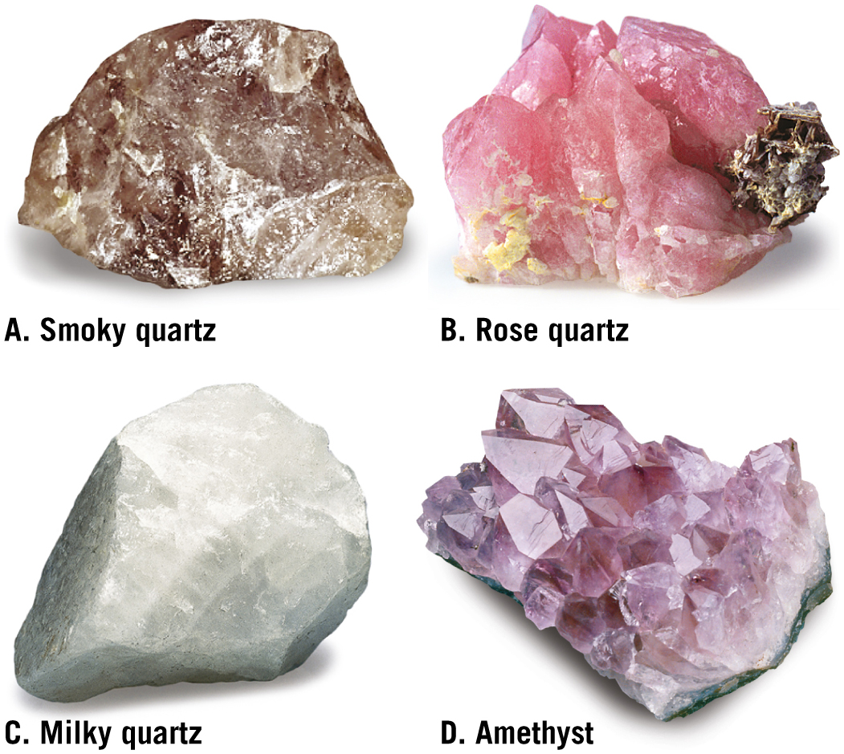
Quartz

Slide 36
3.7 Common Silicate Minerals
The light silicates
Muscovite
Common member of the mica family
Excellent cleavage in one direction
Thin sheets are clear
Used as glass during the Middle Ages
Produces the “glimmering” brilliance often seen in beach sand

Slide 37
3.7 Common Silicate Minerals (cont.)
The light silicates
Clay minerals
“Clay” is a general term used to describe a variety of complex minerals that have sheet structure
Clay makes up a large percentage of soil
Most originate as products of chemical weathering
Kaolinite is common clay mineral used to manufacture fine china

Slide 38
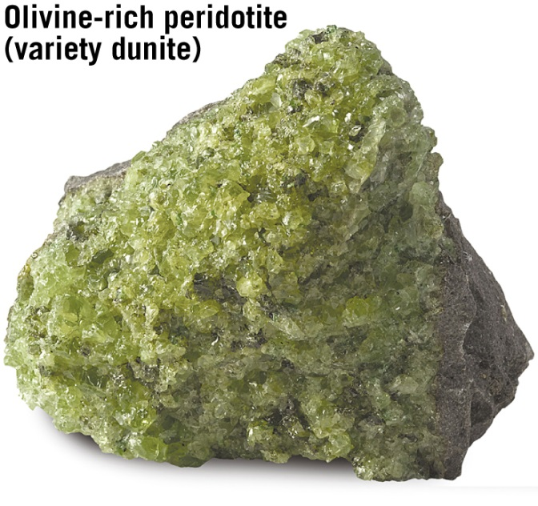
3.7 Common Silicate Minerals (cont.)
The dark silicates
Olivine group
High-temperature silicates
Black to green in color
Glassy luster and conchoidal fracture
Forms small, rounded crystals

Slide 39
3.7 Common Silicate Minerals (cont.)
The dark silicates
Pyroxene group
Important components of dark-colored igneous rocks
Augite is the most common mineral in the pyroxene group
Black in color
Two distinctive cleavages at nearly 90 degrees
Dominant mineral in basalt

Slide 40
3.7 Common Silicate Minerals (cont.)
The dark silicates
Amphibole group
Hornblende is the most common mineral in this group
Two perfect cleavages exhibiting angles of 120 and 60 degrees

Slide 41
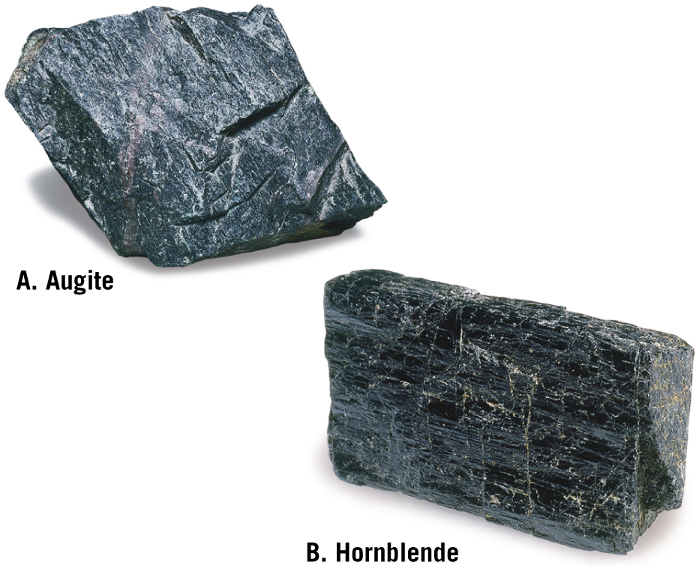
Augite and Hornblende

Slide 42
3.7 Common Silicate Minerals
The dark silicates
Biotite
Iron-rich member of the mica family
Excellent cleavage in one direction
Garnet
Composed of individual tetrahedra linked by metallic ions (similar to olivine)
Glassy luster and conchoidal fracture

Slide 43
3.8 Important Nonsilicate Minerals
Divided into groups based on the negatively charged ion or complex ion that the members have in common
Make up approximately 8% of Earth’s crust

Slide 44
3.8 Important Nonsilicate Minerals (cont.)
Important nonsilicate minerals
Several major groups exist including:
Oxides
Sulfides
Sulfates
Native elements
Carbonates
Halides
Phosphates

Slide 45
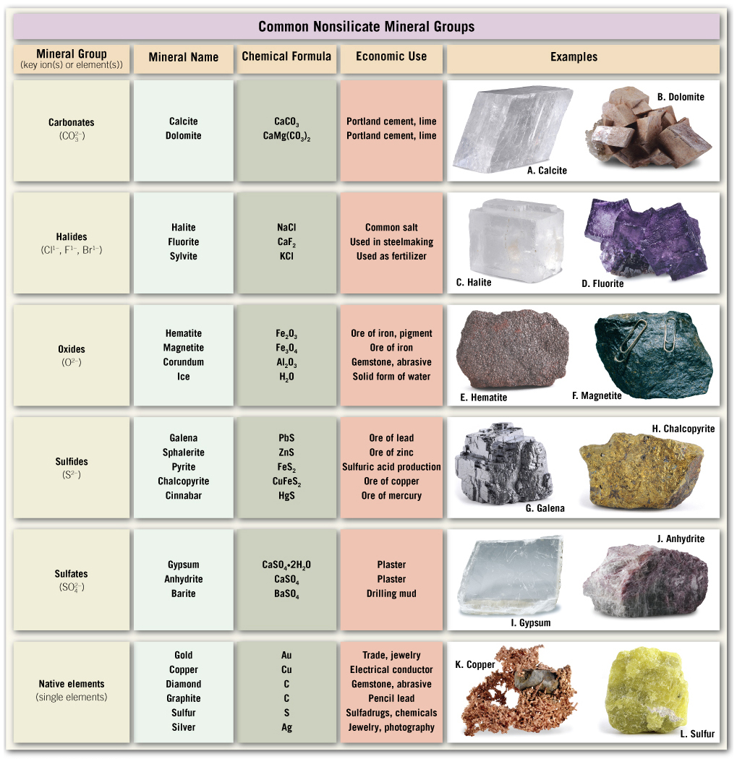
Common Nonsilicate Mineral Groups

Slide 46
3.9 Minerals: A Nonrenewable Resource
Renewable: Can be replenished over short time period
Mineral resources:
Already identified deposits that are currently recoverable
Identified deposits that are not yet economically or technologically recoverable
Ore
A useful metallic mineral that can be mined at a profit
Must be concentrated above its average crustal abundance
Profitability may change because of economic changes

Slide 47
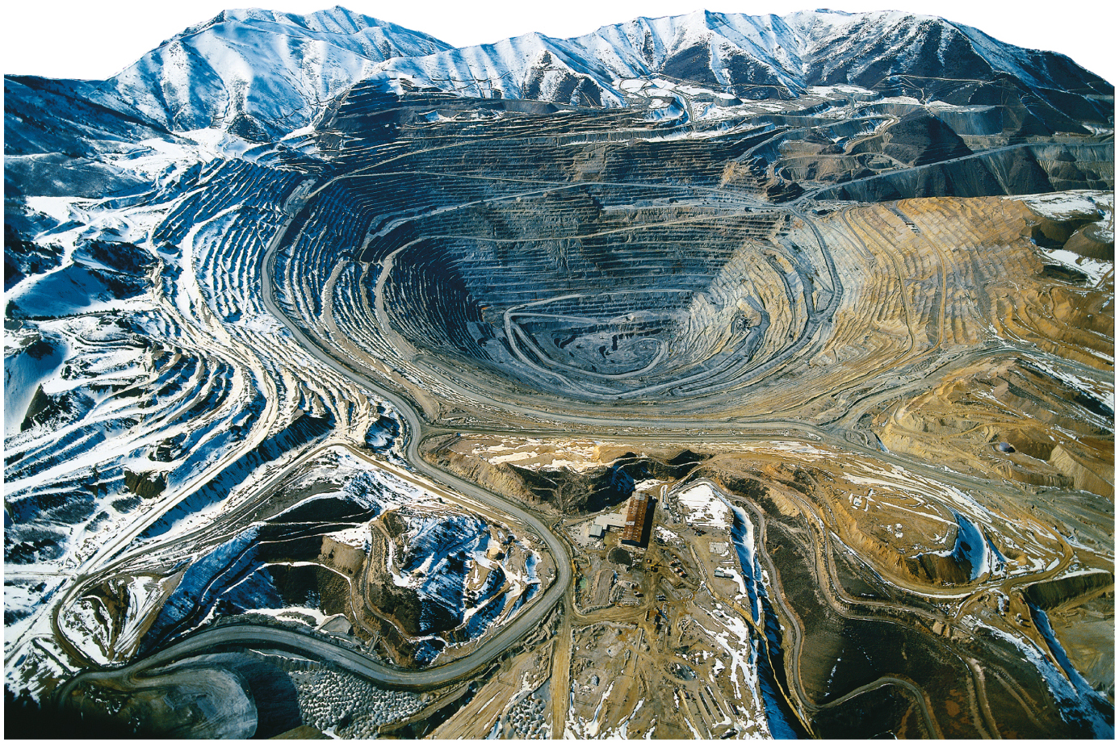
Bingham Canyon Copper Mine, Utah

